Slide 1
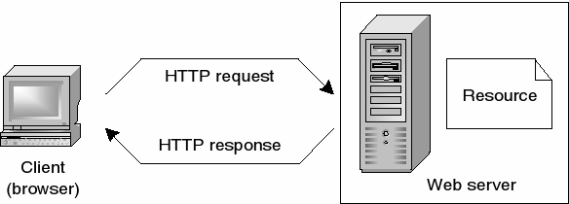
How does the web work?
The backbone of the web is the network of webservers across the world. These are really
just computers that have a particular type of software running on them - software that knows
how to speak the HTTP protocol and knows which information stored on the computer should
be made accessible through the web.

Slide 2
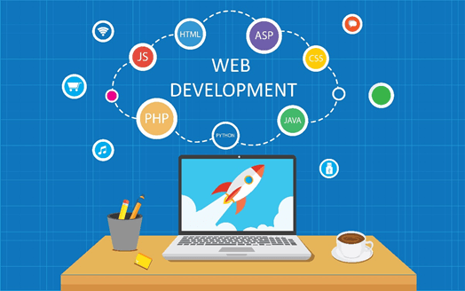
What Does a Web Developer Do?
Web developers are also known as web programmers or coders. They will essentially build a site working on the functionality, visible structure and the interactivity of the site. The context for this construction will usually be provided by the designers and other personnel with key roles. As a web developer you will also be responsible for making sure that a site functions in the right way on all the browsers that it may be accessed on and across all devices. Once that site has gone live, you will carry out all the updates needed and maintain other daily tasks as needed.

Slide 3
What Skills Do You Need to Become a Web Developer?
When you learn web development, not only will your theoretical and practical knowledge improve, but you will also be groomed on the main skills that you need for the job such as;
Computer literacy
Strong numeracy skills
Creative ability
Attention to detail
Excellent communication skills
Excellent problem solving skills
A logical work ethic
The capability of explaining technical matters clearly to anybody
A keen and active interest in technology and the ability to stay updated about it

Slide 4
What is a Web Developer?
A web developer is responsible for programming the code that “tells” a website how to function. A developer builds a website from the bottom up, which means designing it in such a way that end users have no difficulty navigating the site. The website should not be so simple that it does not appeal to advanced users, nor should it be so complicated that the beginner is easily lost in the process.
Web development can be divided into three parts: code that executes in a web browser and determines what customers or clients will see when they land on a website (client-side scripting); code that executes on a web server and powers the behind-the-scenes mechanics of how a website works (server-side scripting); and database technology, which helps to keep a website running smoothly and efficiently. Large-scale web projects often divide these tasks among multiple web developers.

